Slide 1
Apply to be CS106L Lecturer! 🧑‍🏫️🧑‍💻️🎉

Slide 2
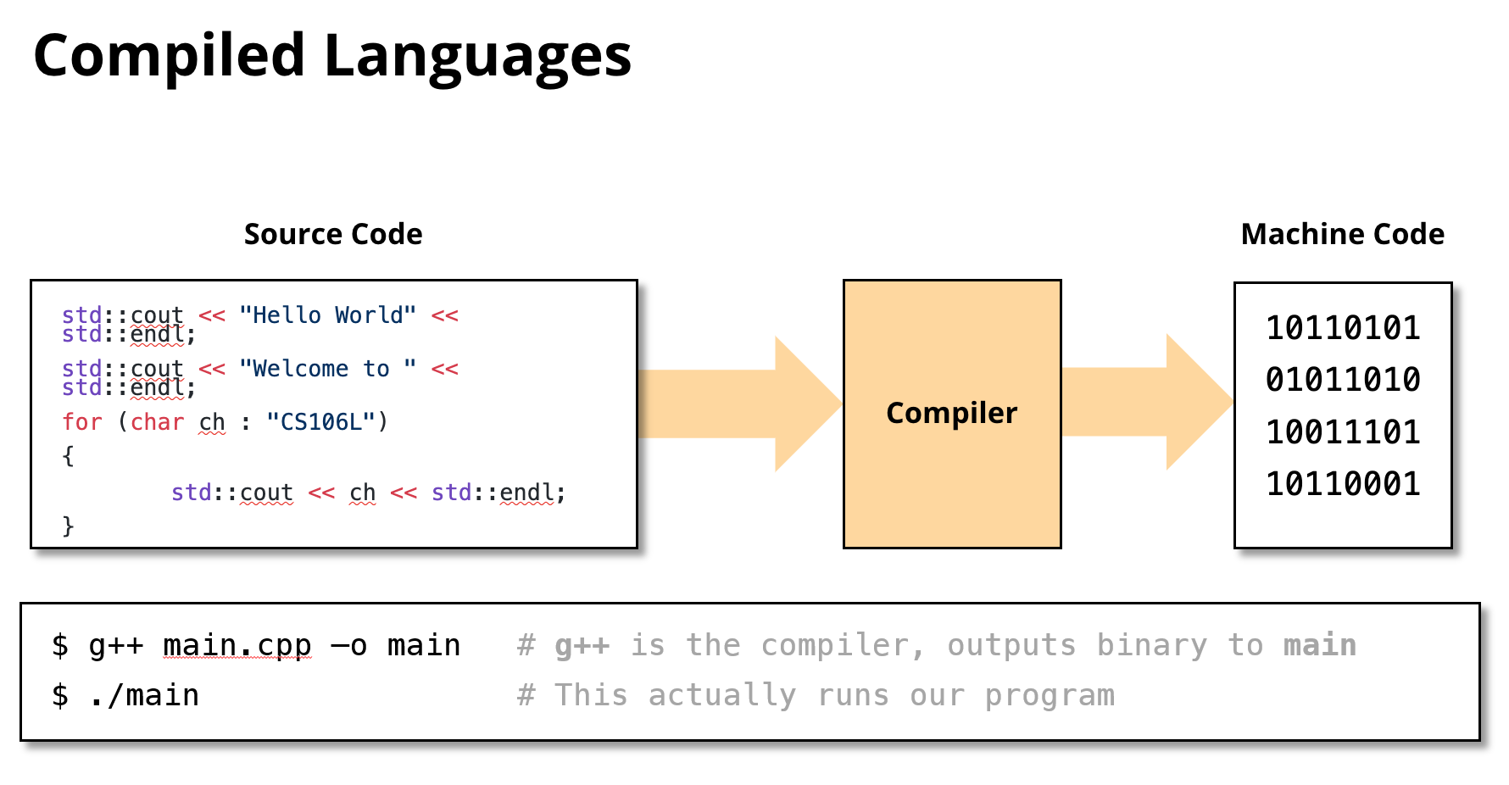
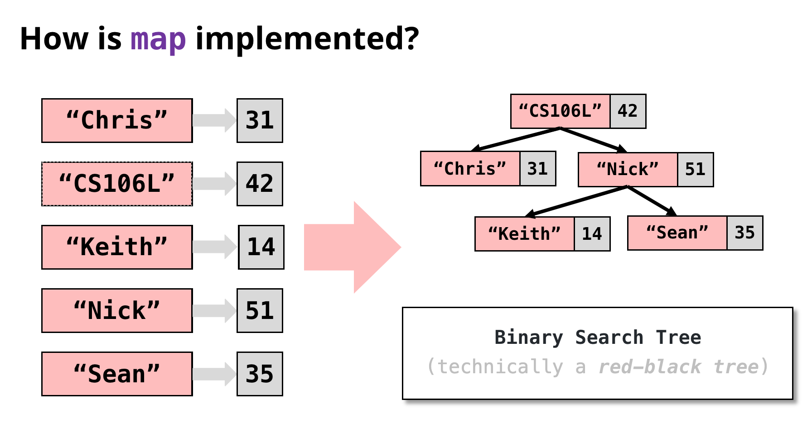
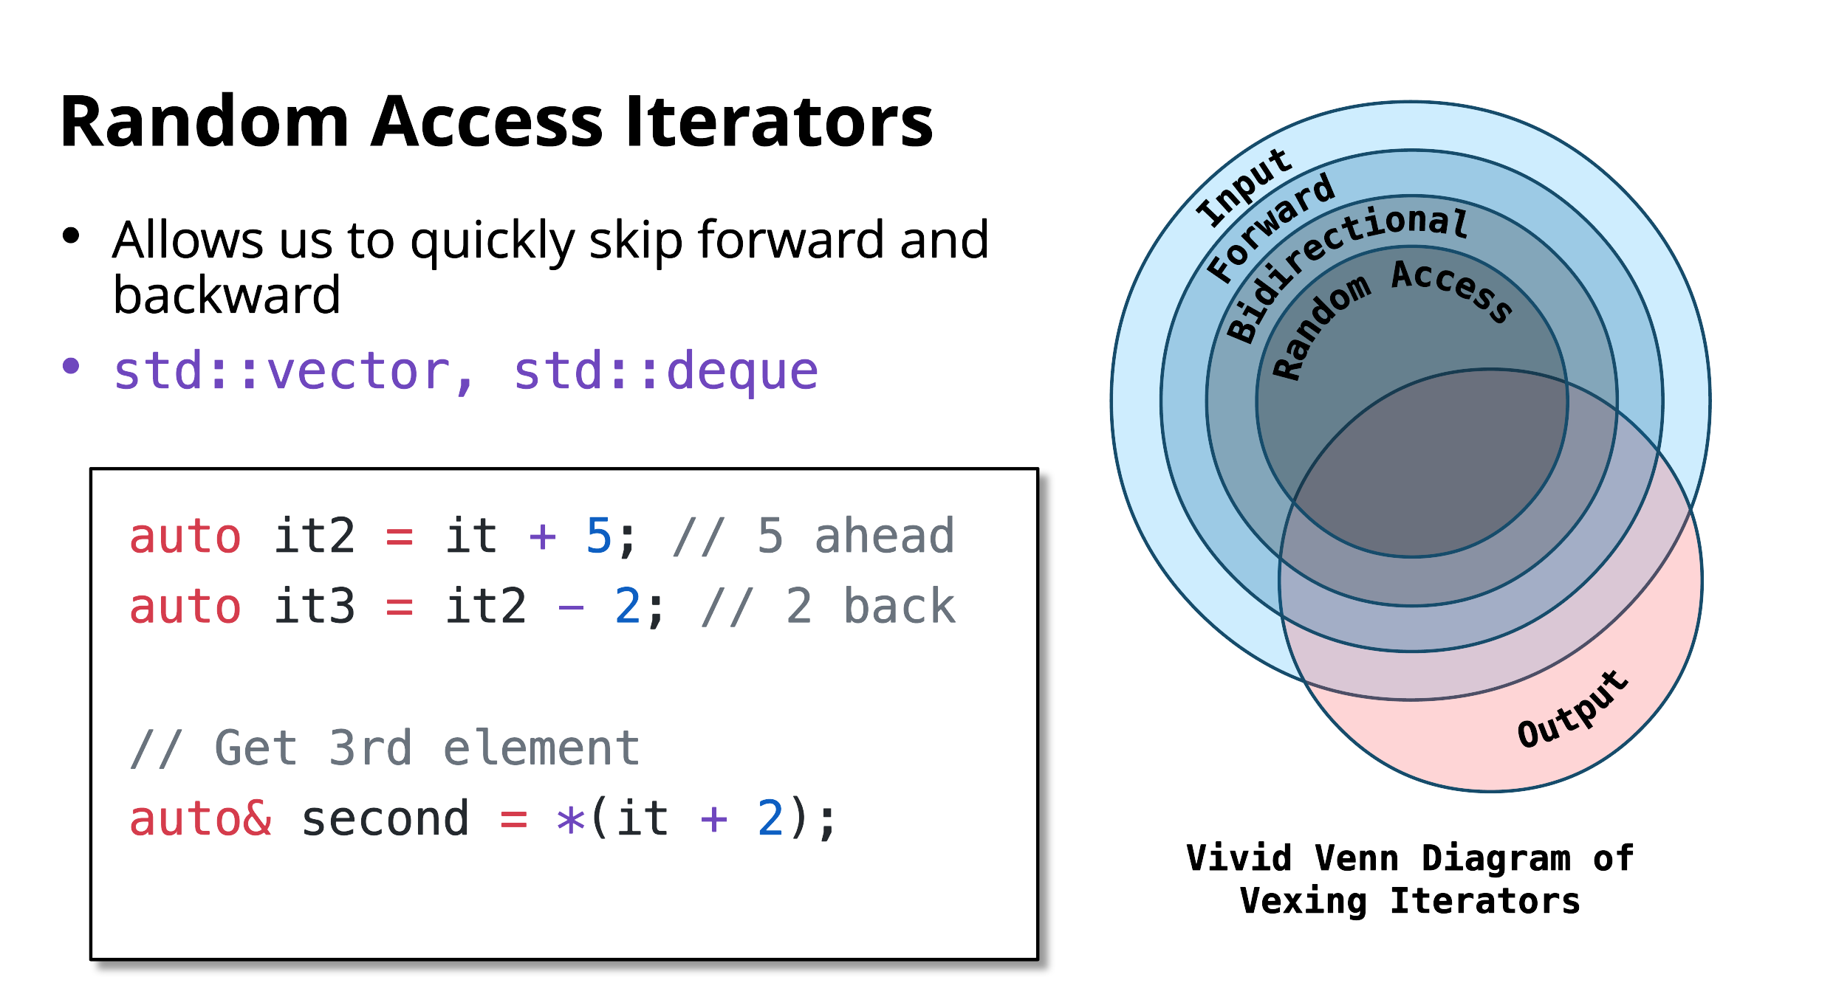
You get to design a course…

Slide 3
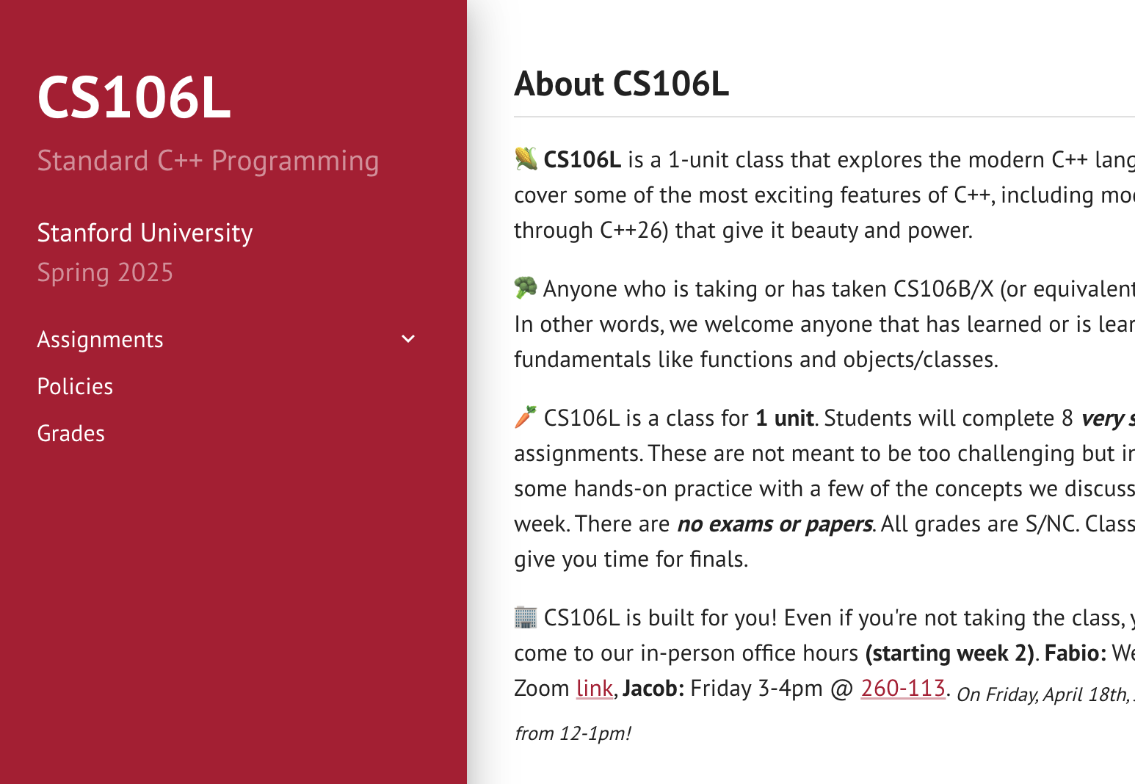
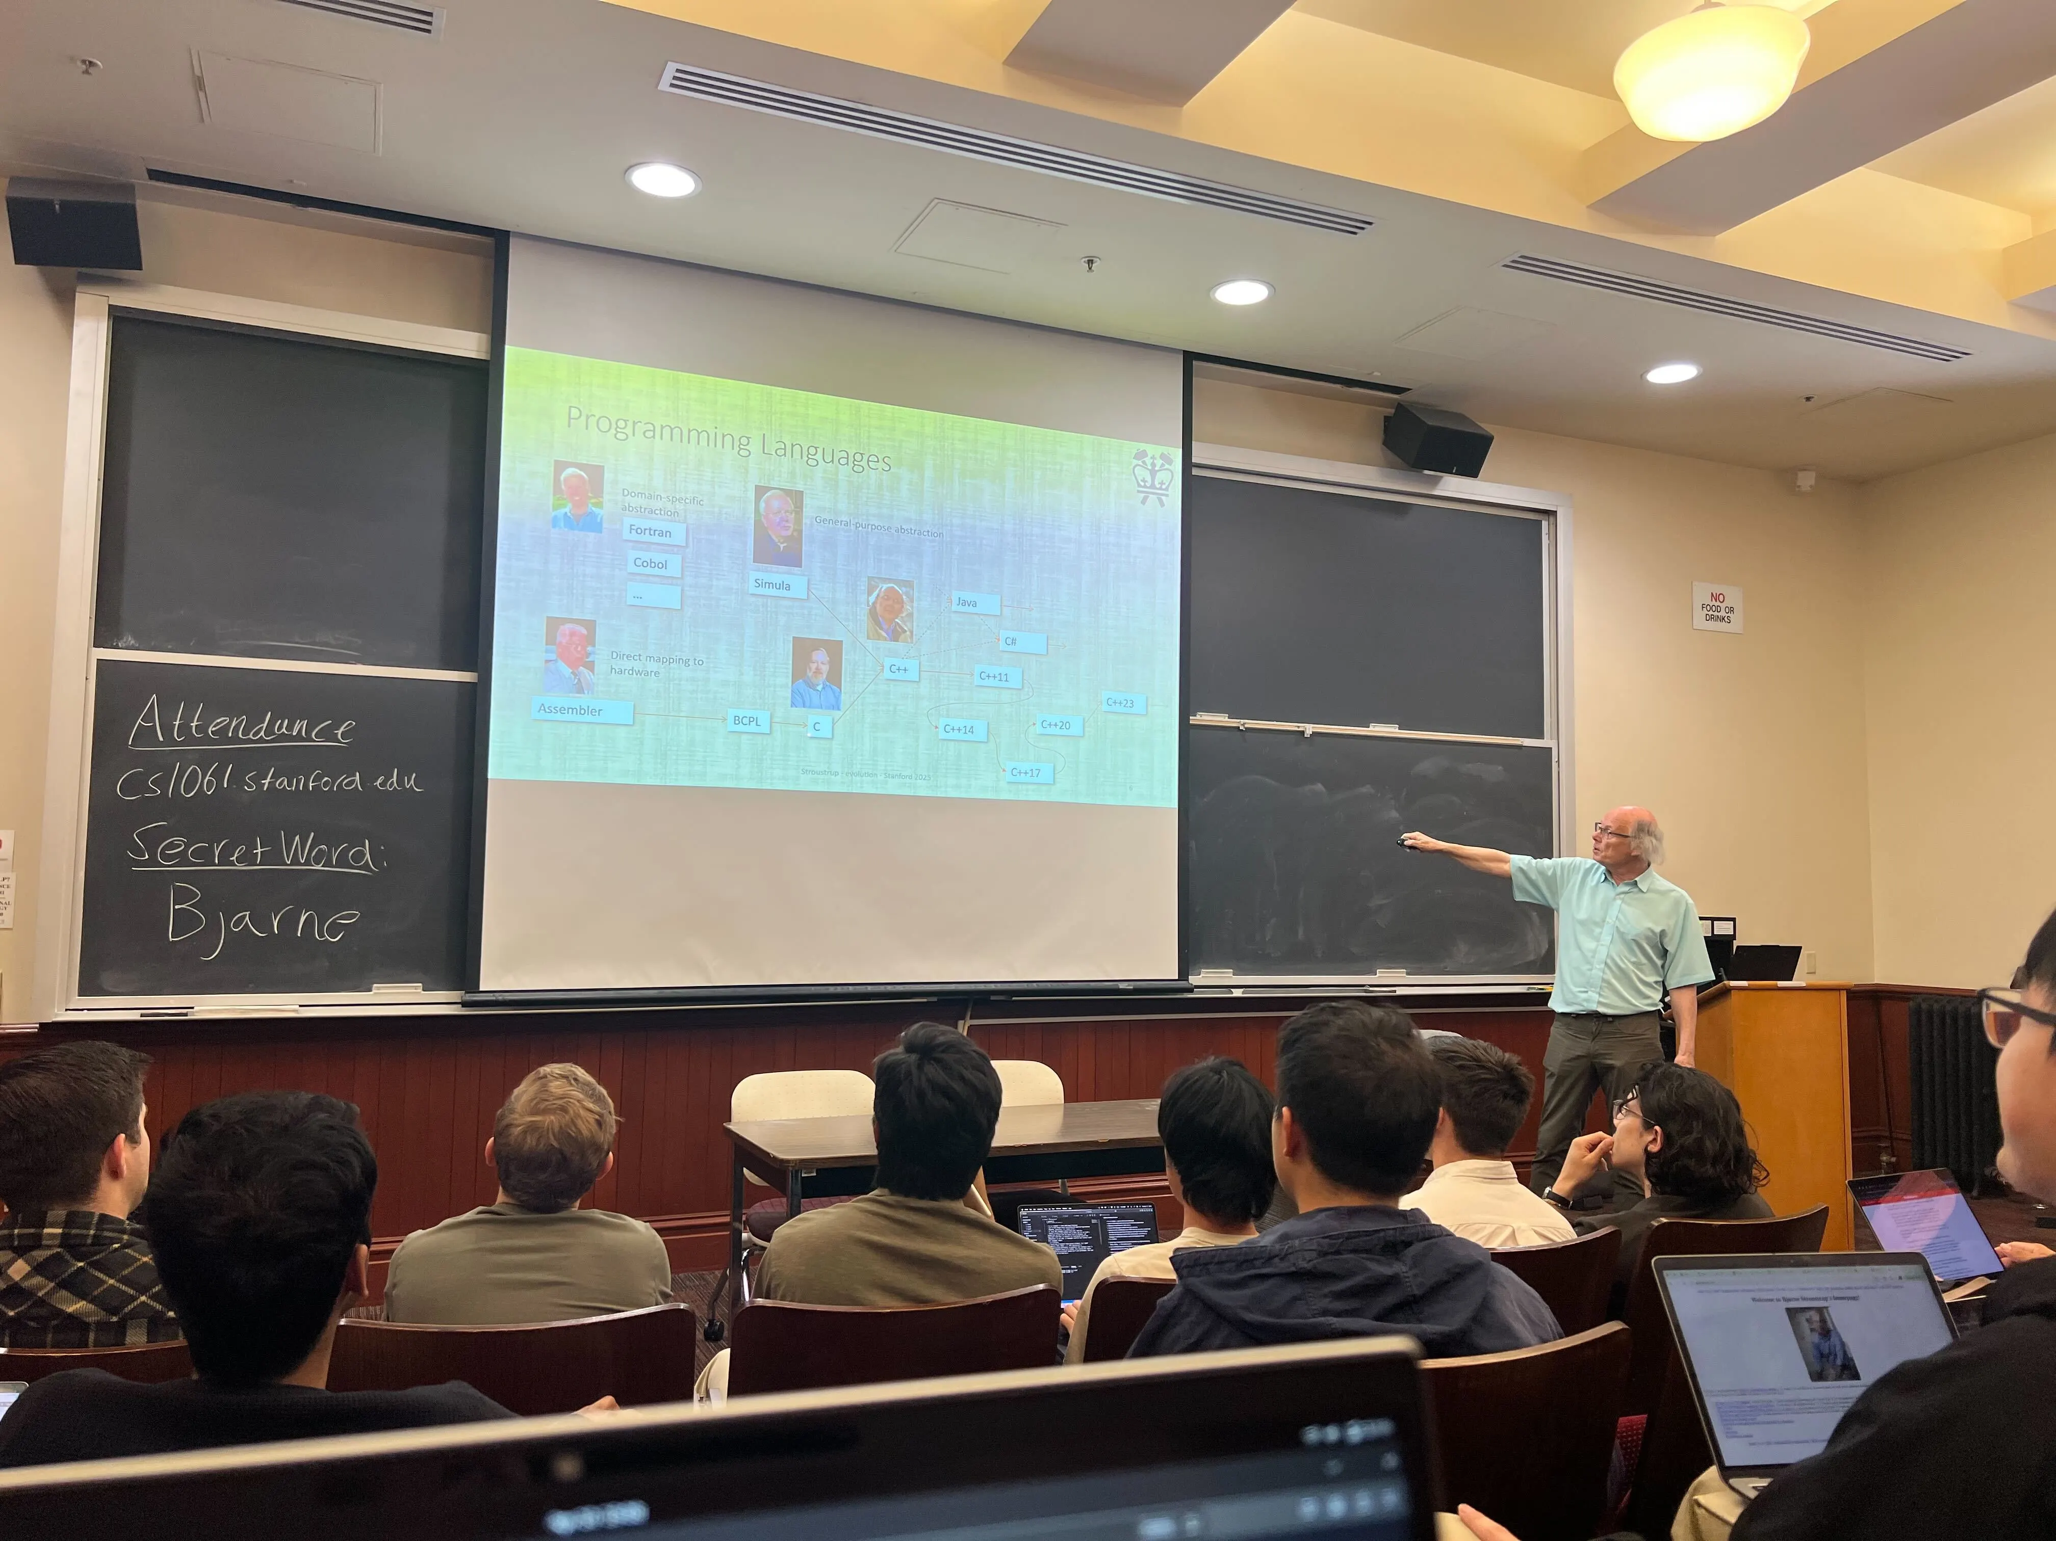
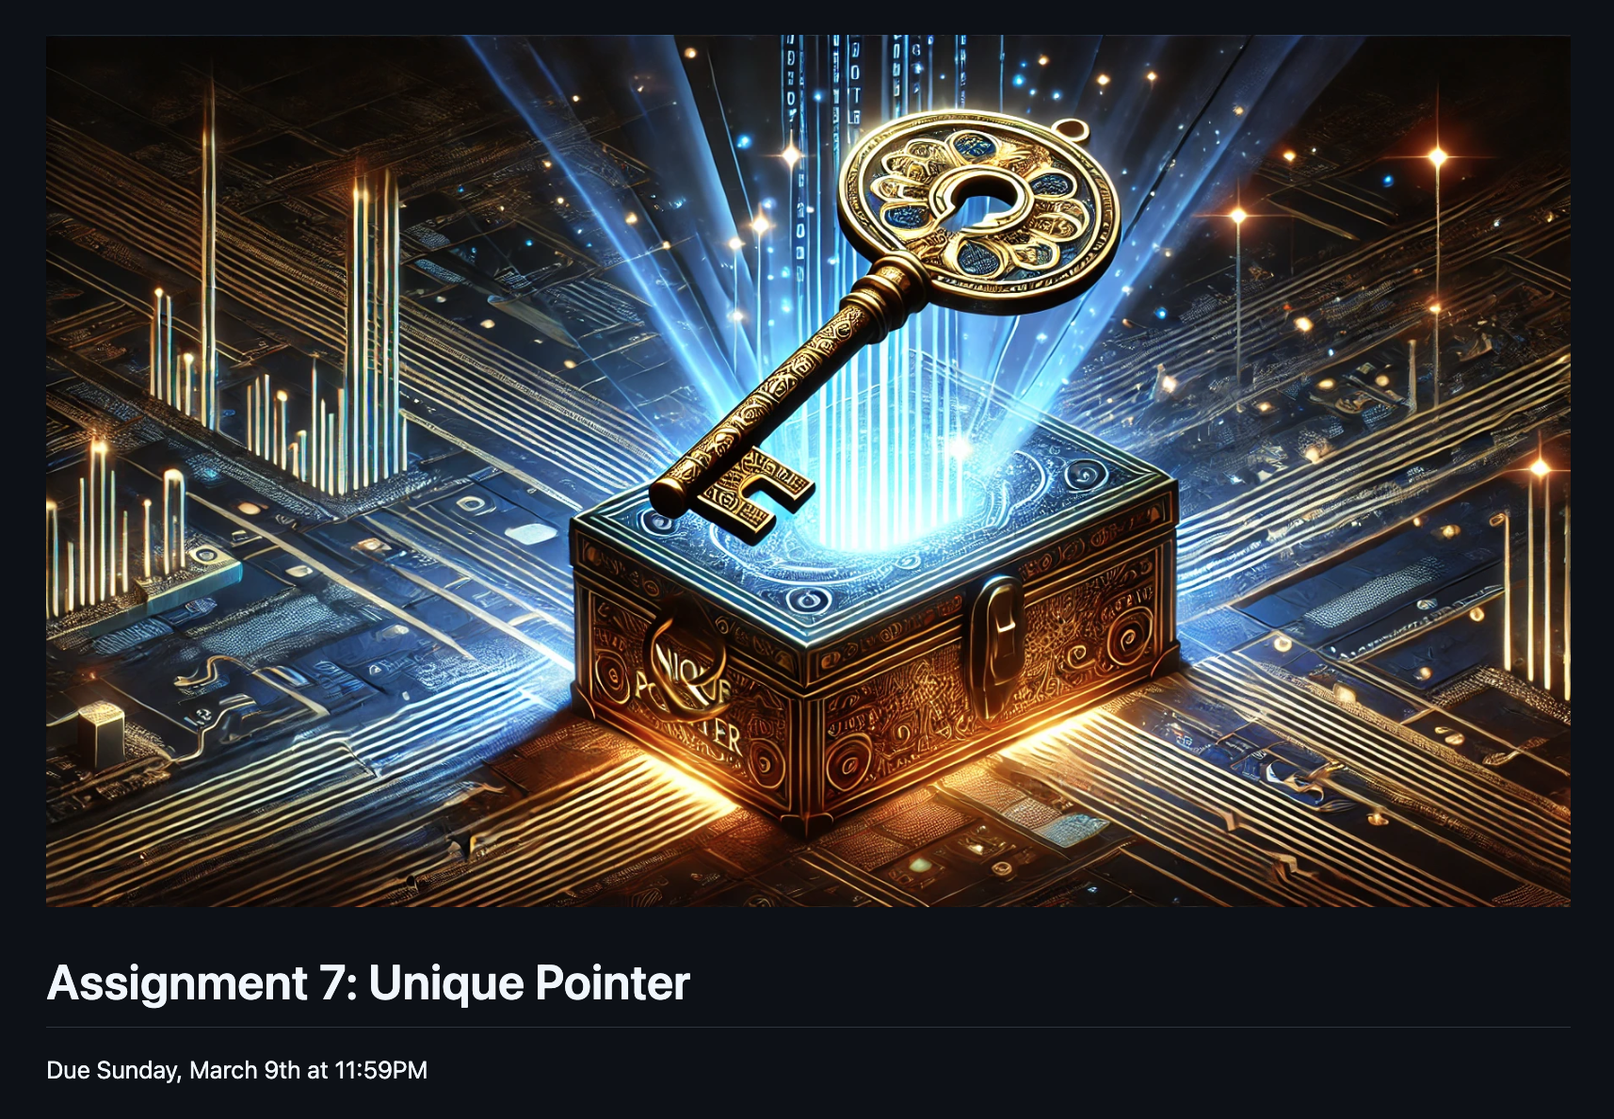
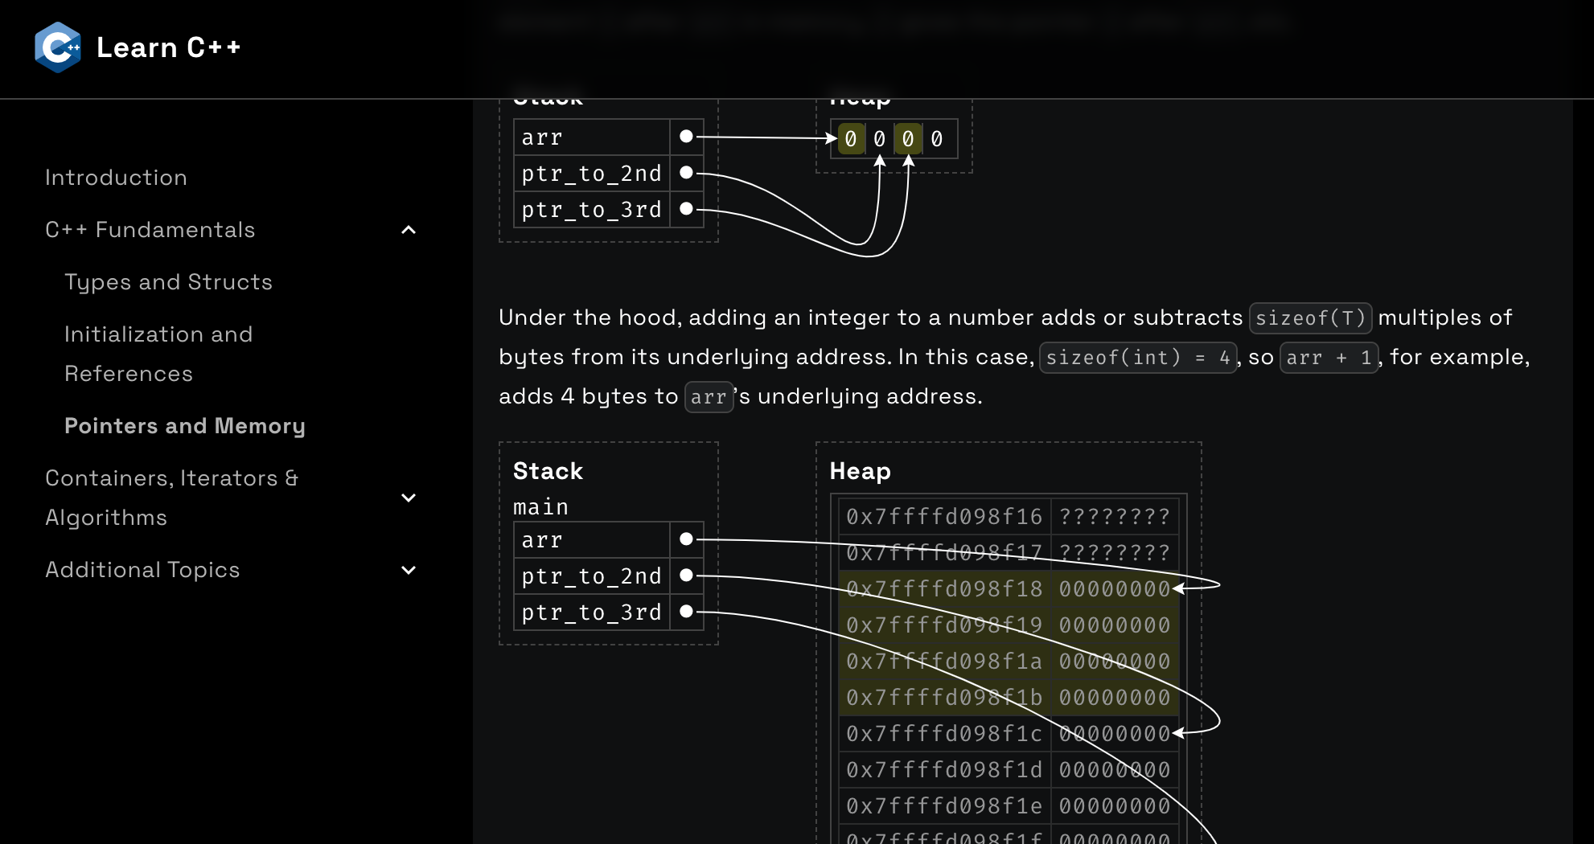
…and so much more
Bjarne Stroustrup
(he created c++)

Slide 4
A few important details
New SLs are welcome to apply! 👶
You don’t need to know C++ beyond CS106B! 🤓
You will learn on the job
There are few opportunities like this at Stanford
Reach out to us!

Slide 5
We want to hear from you! Apply at cs198.stanford.edu by Friday, April 25

